Slide 1
InvestMate - The Investment App

Slide 2

InvestMate

Slide 3

About us
At InvestMate, we understand the challenges and complexities involved in stock market investment and risk management. Our mission is to empower investors—both novice and experienced—by providing the tools, insights, and resources they need to navigate the volatile world of stock markets with confidence and clarity.

Slide 4

Application benefits
- Simplifies the investment process with a user-friendly interface and real-time market data.
- Provides personalized investment strategies and portfolio diversification tools.
- Enhances decision-making with predictive analytics and educational resources.

Slide 5
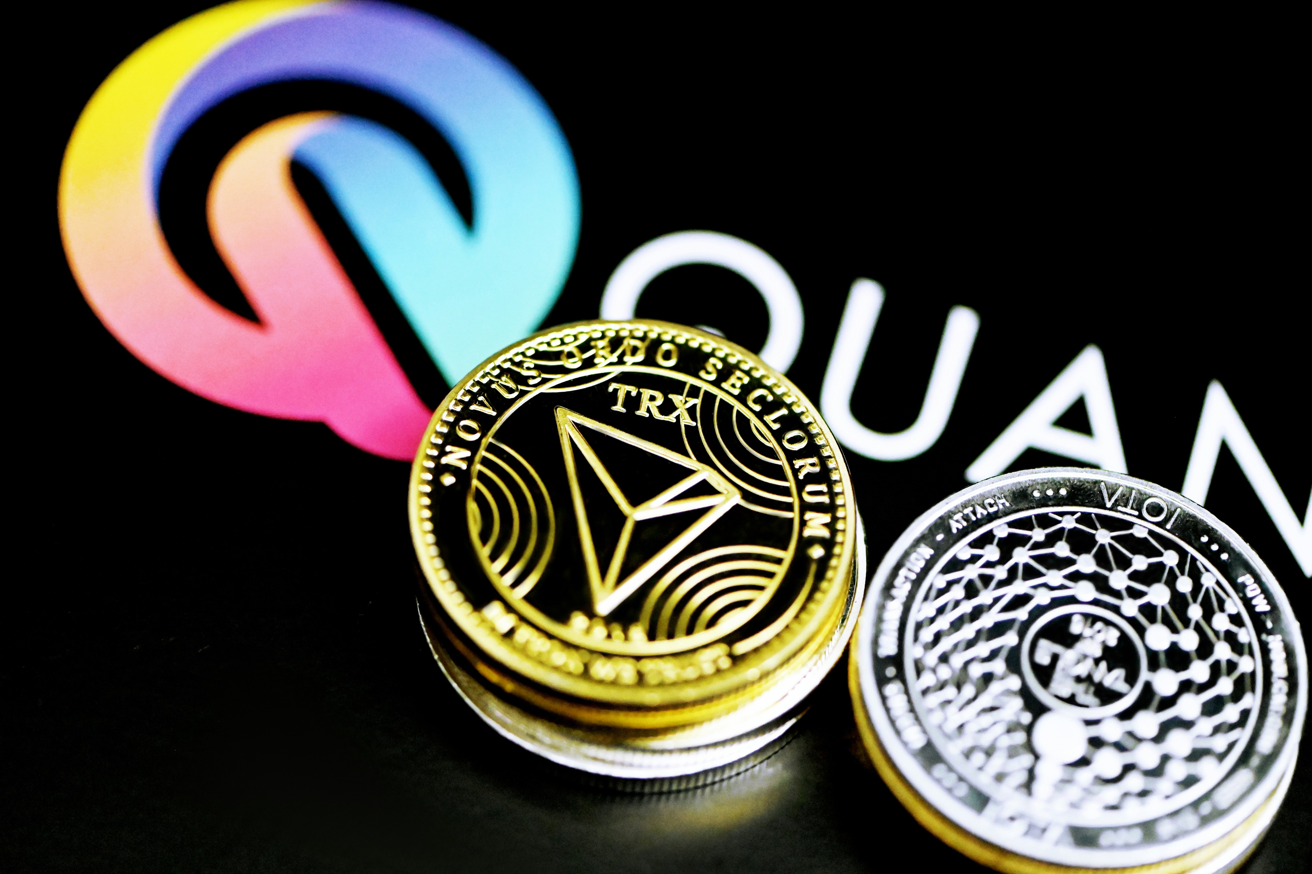
FUNCTIONAL REQUIREMENTS
NON-FUNCTIONAL REQUIREMENTS
User Registration
Real-Time Market Data & News
Financial Analysis & Research Tools
Portfolio Management
Performance Requirements
Usability Requirements
Easy To Use

Slide 6



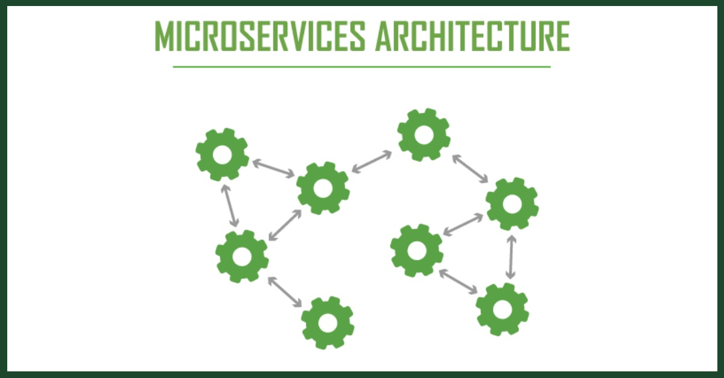


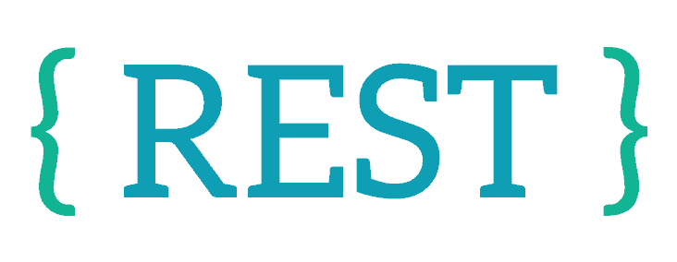
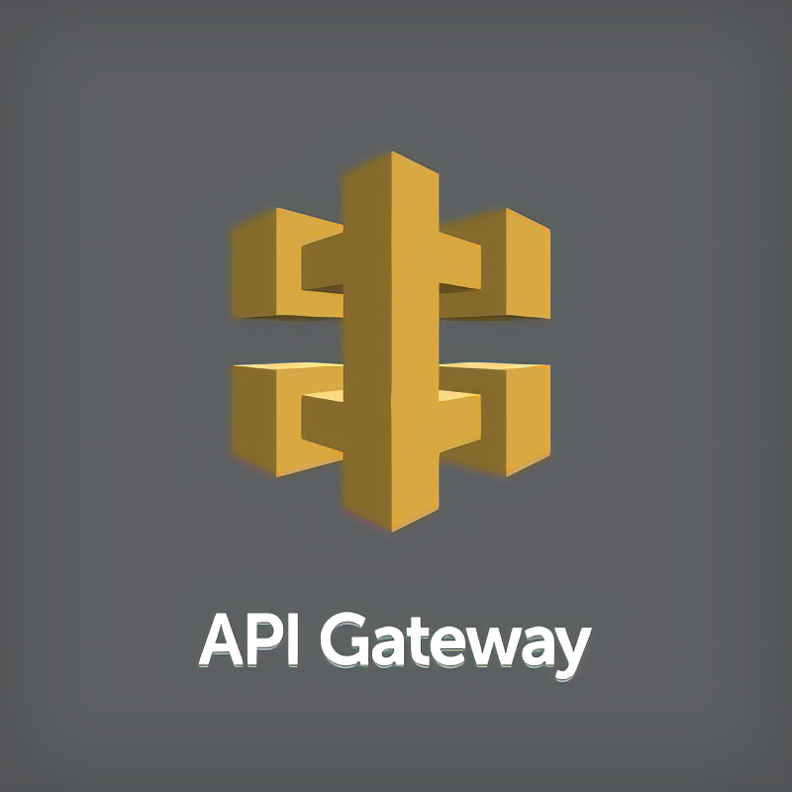


TECHNOLOGIES AND TOOLS USED

Slide 7

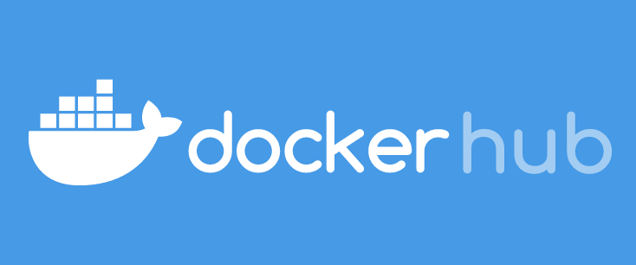
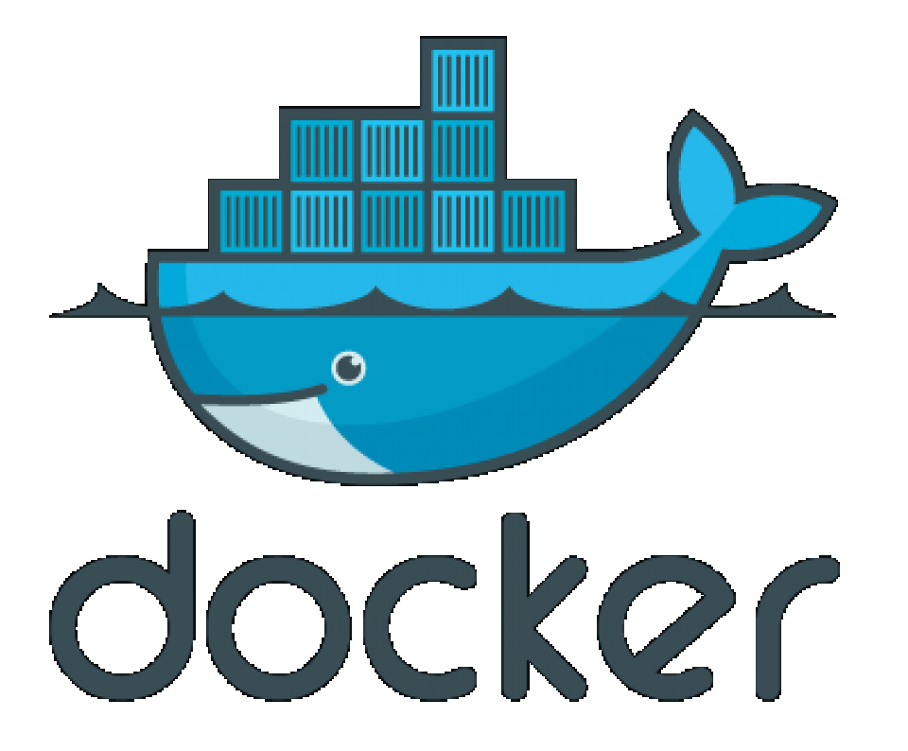
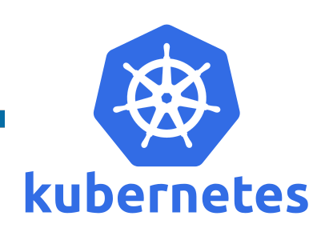
CLOUD SERVICES

Slide 8
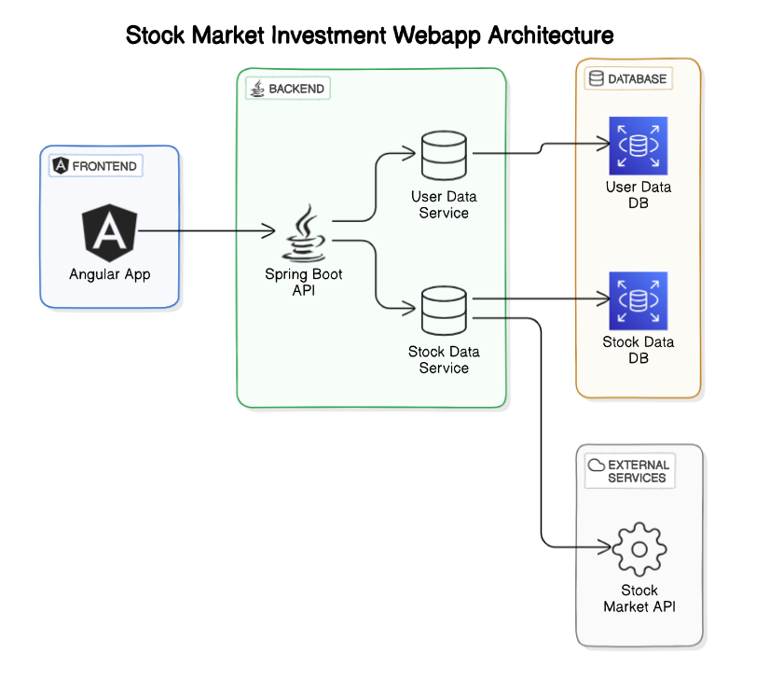
APPLICATION ARCHITECHTURE

Slide 9
APPLICATION FEATURES
Investor Can
Login / Sign Up
Add/Delete/Modify Portfolio
Buy/Sell Available Stocks
Keep an Eye on Stocks Details

Slide 10
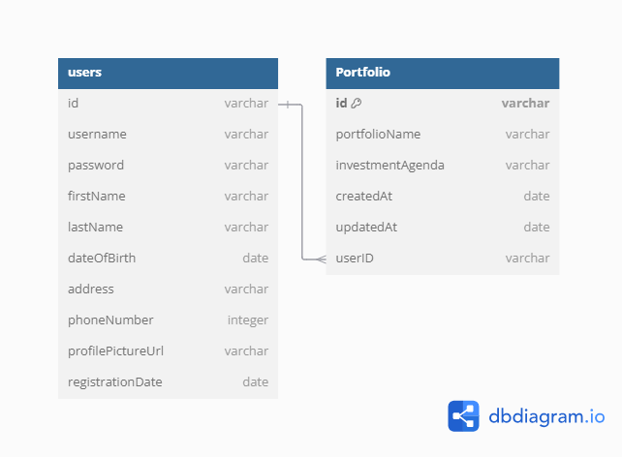
DATABASE DESIGN

Slide 11
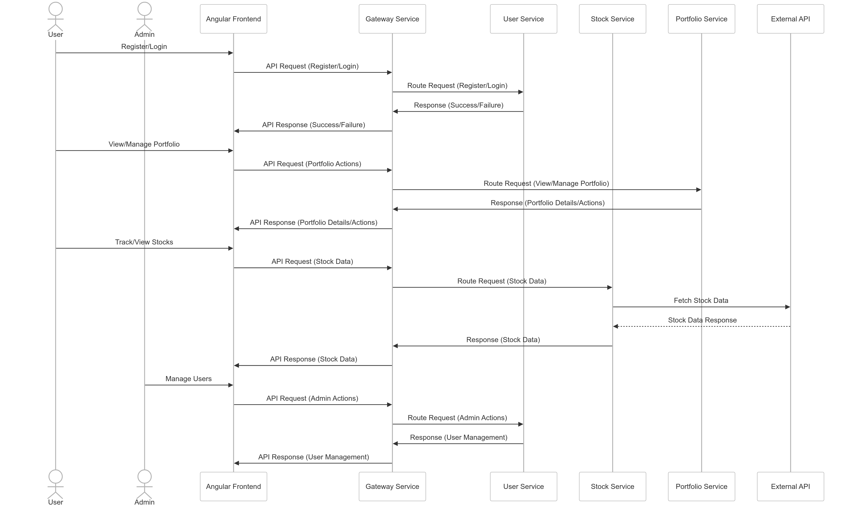
PROJECT FLOW

Slide 12

Thank you,
For providing this opportunity to develop this application and allowing us to present it.

